Slide 1
X-ray: Automating Root-Cause Diagnosis of Performance Anomalies in Production Software
Mona Attariyan
Michael Chow
Jason Flinn
Presented By: Prasanna Gautam

Slide 2
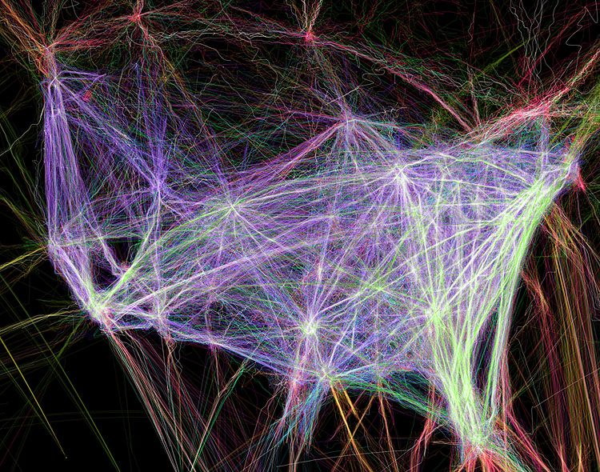
Software is Complex
Source: http://cybersecurity.mit.edu/2013/09/the-security-costs-of-software-complexity-an-introduction/

Slide 3


How do you troubleshoot complex software?
Developer | User/Administrator
Look at Logs | Did you try turning it off and on again?
Look at Traces | Tweak configuration until it works
Profile | Ask Google
Source code
Notes:
It depends on how much you know about the software

Slide 4
What if we could..
Give more insight to users and administrators
Automatically
Without escalating to the developers
Without requiring complex instrumentation from the developers
Get a summary of performance anomalies

Slide 5
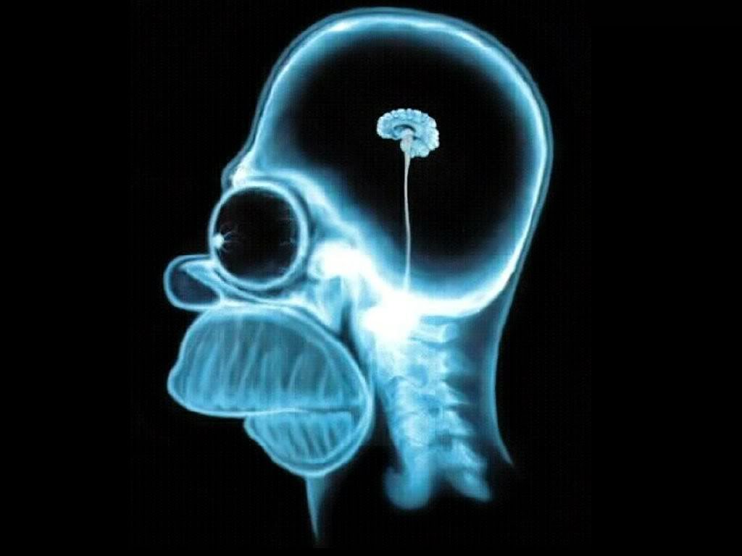
Introducing X-Ray

Slide 6
Goals
Help diagnose performance issues without:
Source code
Error or Log Messages
Provide performance summarization
Get overall cost of each potential root cause

Slide 7
Example Use cases
Configuring Apache web server
Fickle configuration files
Lots of tweaks and arcane error messages
Postfix mail server user
Troubleshooting involves using a variety of tools
Changing configuration parameters..
And so on…

Slide 8
Current tools
Current tools are lacking in finding root cause of anomalies
They can tell you “what” happened
And “how” if you have logs and traces
End users need to manually infer “why”
Potential root causes
Configuration
Input
Load

Slide 9
Performance Summarization
Finding root cause of performance problem is like finding needle in a haystack
Profilers do this by brute forcing all paths
Extend this approach…
By combining causal analysis of every event
Event is instruction or system call
Attribute costs to all potential root causes
End result: a cost breakdown of various potential root causes

Slide 10
Performance Summarization
Find all Events within scope
Attribute costs to events
Find Root Cause
Aggregate costs by cause
Sort by cost

Slide 11
Core ideas
Deterministic Replay
Using Pin and custom tool
Causality analysis

Slide 12
Replaying
Record and replay executions may be highly different
Used Pin
Had too much overhead (20%)
Had to account for the locking strategy Pin used
New replay tool
Adds overhead of 1-5%

Slide 13
ConfAid
Automating configuration troubleshooting with dynamic information flow analysis
Instruments binaries to monitor causal dependencies
Correlates the erroneous behaviors to specific tokens in configuration files
Uses taint-tracking to determine causality

Slide 14
ConfAid: Taint Tracking
Assign weights to taints to represent strength
Rules
Data flow taint > Control flow taint
Closer branches > Distant branches
Direct control flow > Indirect control flow
Attribute root causes to all events

Slide 15
X-Ray – Request Extraction
Identifies basic building blocks that handle request
Scope : portion of execution to analyze
Entire execution
Multiple requests for differential comparison
Two methods supported by X-Ray

Slide 16
Request Extraction – Method 1
Process level
Use External communication
Coarse metrics
Incapable of inferring causal paths for multi-threaded and event-based applications

Slide 17
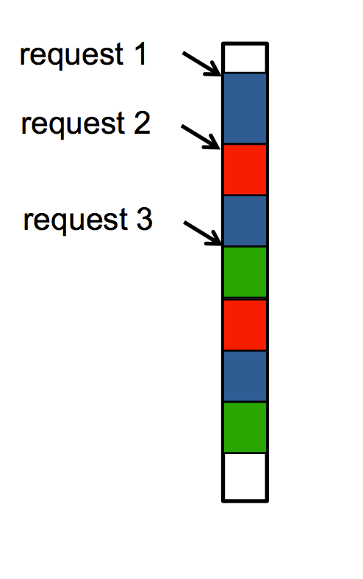
Request Extraction – Method 2
Directly track data and control flow taint
Assign basic block to request with most weight
Uses same taints as ConfAid

Slide 18
Request Extraction - Outputs
Each Block
<Id, Address, Count> tuple
Id: Linux process/thread Id
Address: first instruction block in the executable
Count: # of instructions executed prior to first instruction of block

Slide 19

Cost Metric Choices

Slide 20
Cost Metric Choices
Latency | # of user level instructions executed in each time period
CPU Utilization | # of instructions executed in each basic block
File System Use | Observes replayed executions for file descriptors
Network Throughput | Same as Filesystem I/O
Two passes:
First pass – also attributes to all events, but are aggregated to blocks as performance optimization
Second pass – Performance Summary

Slide 21
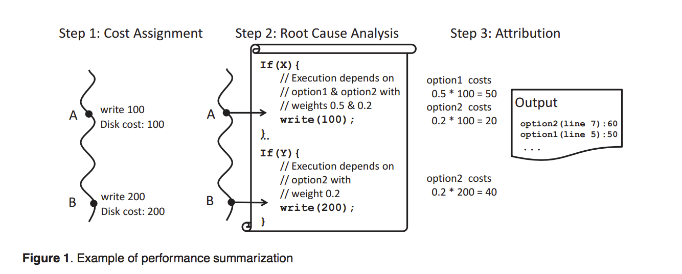
Example: Performance Summarization

Slide 22
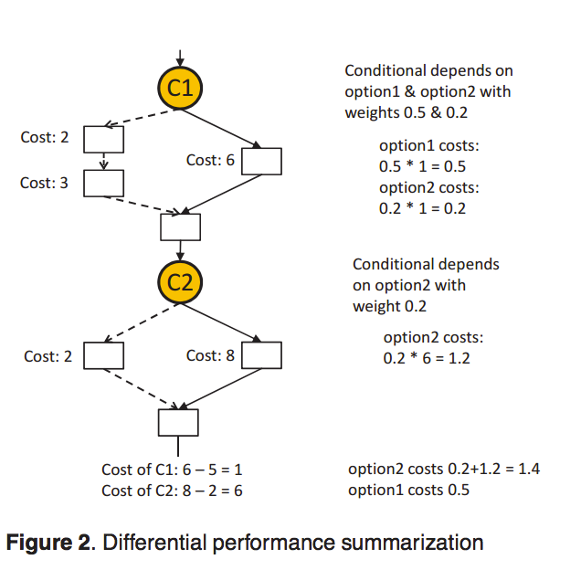
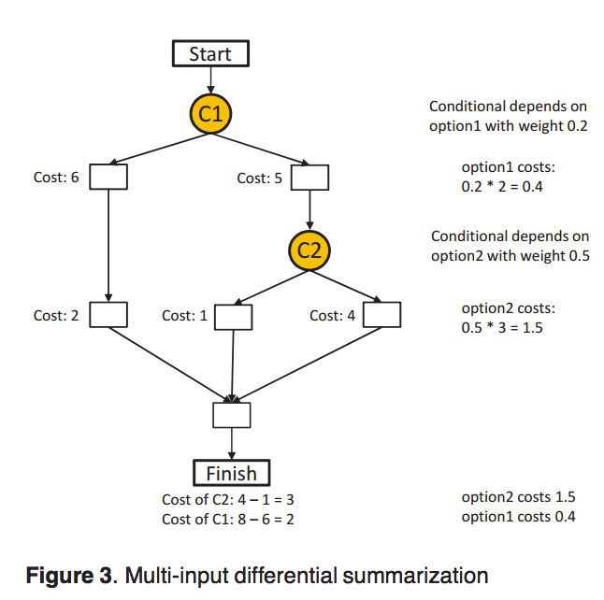
Differential Performance Summarization

Slide 23
Evaluation
Root identification accuracy
Overhead
Troubleshooting problems with X-Ray
Is it faster?

Slide 24
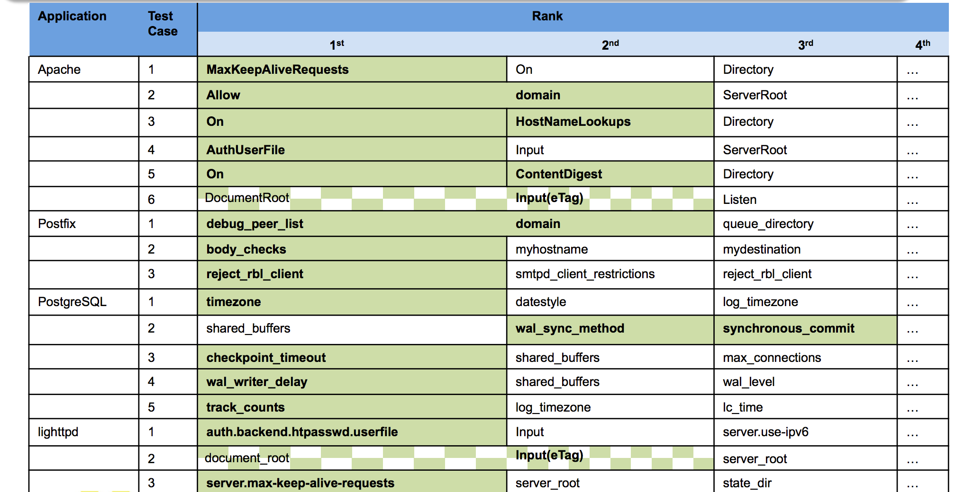
Results
Looked at 4 apps, 17 performance bugs

Slide 25
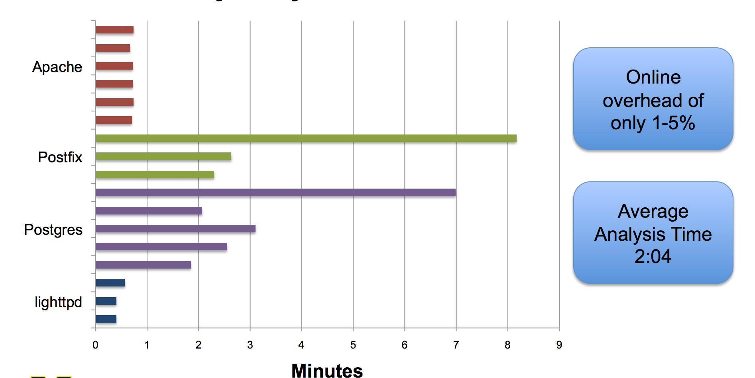
Results
Correct root cause(s) ranked or tied for first in 16 out of 17
https://www.usenix.org/sites/default/files/conference/protected-files/attariyan_osdi12_slides.pdf

Slide 26
Limitations
Tied to User-Space for tracking causality
Only depends on configurations settings and inputs
Multi-path analysis sometimes produced erroneous results due to infeasible shortest paths.

Slide 27
Conclusion
Designed to run in production
High degree of accuracy (16/17 bugs)
Low overhead

